Slide 1

Automated IELTS Essay Evaluation Using Transformer-Based Models
Evaluating IELTS essays manually is time-consuming, subjective, and often inconsistent across evaluators. This project proposes an automated system for rubric-based evaluation of IELTS essays using transformer-based sentence classification models.
By leveraging the contextual understanding capabilities of transformer architectures like BERT, the system classifies individual sentences based on specific IELTS rubric criteria: Task Achievement, Coherence and Cohesion, and Lexical Resource. The sentence-level classifications are aggregated to generate detailed feedback aligned with IELTS standards, improving evaluation consistency and reducing grading time.

Slide 2




The Challenge of Manual IELTS Essay Evaluation
Time-Consuming Process
Subjective Assessment
Human evaluators must carefully read and assess each essay against multiple criteria, requiring significant time investment per essay.
Manual evaluation introduces inconsistencies between graders, personal biases, and fatigue-related errors.
Scalability Issues
Traditional evaluation methods struggle to handle large volumes of essays efficiently while maintaining quality standards.

Slide 3








Project Objectives and Scope
Automate Rubric Classification
Classify sentences by IELTS criteria
Support Human Graders (Don't replace but enhance)
Highlight relevant text portions by category
Reduce Evaluation Time
Provide structured overview of strengths/weaknesses
Enhance Grading Consistency
Minimize subjectivity and grader variability
The project focuses on three key IELTS rubrics: Task Response, Coherence and Cohesion, and Lexical Resource, while excluding Grammatical Range and Accuracy due to its highly syntactic nature that demands specialized grammar analysis.

Slide 4
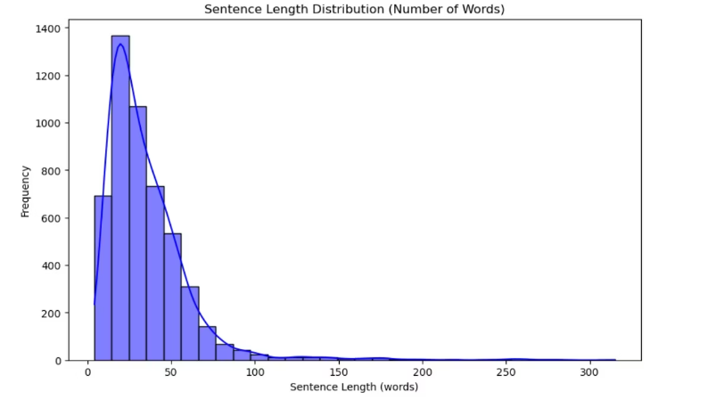
Dataset Characteristics and Distribution
The project utilizes a specialized IELTS Essay Dataset collected from reputable online educational platforms and IELTS preparation websites. This dataset includes diverse essay types, topics, and student ability levels, providing a realistic foundation for model training.
Each essay was manually segmented into individual sentences and labeled according to the primary IELTS rubric it contributes to: Task Response (TR), Coherence and Cohesion (CC), or Lexical Resource (LR).
The distribution of sentence lengths shows most sentences contain between 20-50 words, with a right-skewed distribution extending toward sentences exceeding 100 words. This reflects typical academic writing patterns in IELTS essays.

Slide 5
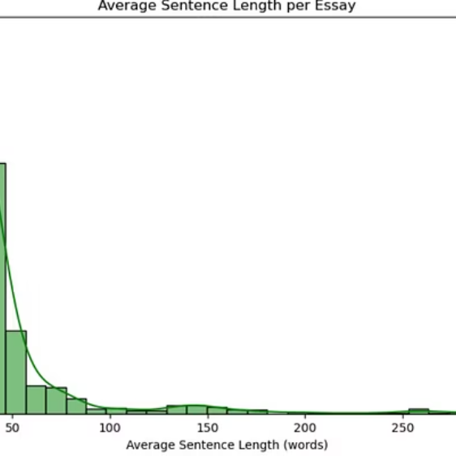
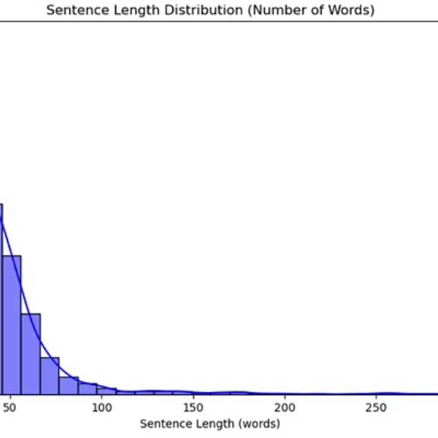
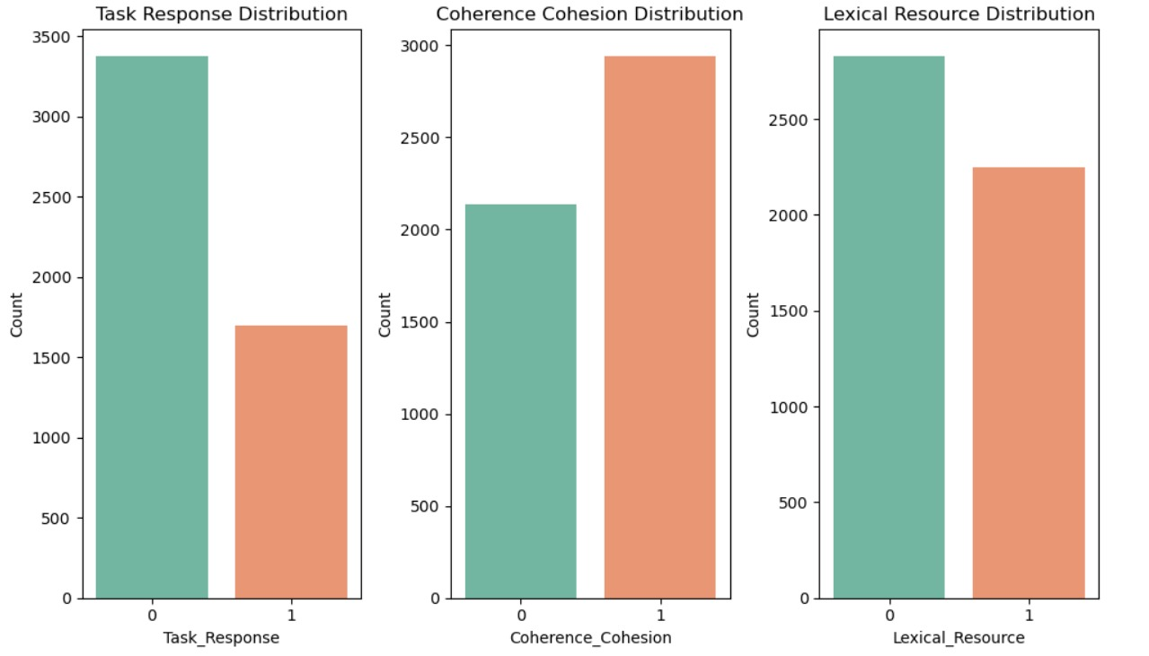
Essay Length and Sentence Structure Analysis
The dataset analysis reveals most essays have an average sentence length between 30-50 words, indicating that clear and concise writing is typical among IELTS candidates. This aligns with academic writing best practices that emphasize clarity and precision.
The distribution of sentence labels across the three primary IELTS rubrics shows a balanced representation, ensuring the model can learn to distinguish between different aspects of essay quality. This balanced distribution is crucial for developing a fair and comprehensive evaluation system.

Slide 6
Data Preprocessing Pipeline
Dataset Splitting
The full dataset was split into 80% training and 20% validation sets, with stratified sampling by rubric label to maintain balanced representation across all categories.
Sentence Segmentation
Essays were divided into individual sentences using NLTK's sent_tokenize, with special attention to handling abbreviations, missing punctuation, and compound sentences correctly.
Rubric Label Assignment
Sentences were labeled into three IELTS rubric categories (TR, CC, LR) either manually or semi-automatically, then verified by human annotators to ensure accuracy.
Text Normalization & Tokenization
Minimal cleaning was applied to preserve authenticity, with spelling and grammar errors intentionally preserved. Sentences were tokenized using a BERT transformer tokenizer.

Slide 7
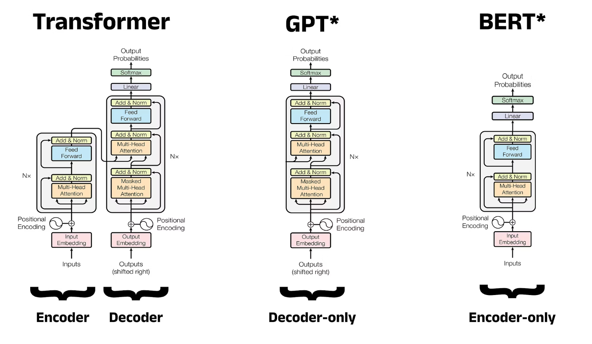

Slide 8



Comparing Transformer Architectures
Encoder-Decoder (Transformer)
Decoder-Only (GPT)
Encoder-Only (BERT)
Masked Multi-Head Attention: Prevents tokens from attending to future tokens (causal).
Bidirectional Attention: Allows tokens to attend to both past and future tokens.
Encoder: Processes the input sequence using layers of multi-head attention and feed-forward networks.
Feed-Forward Layers: Applied after attention.
Feed-Forward Layers: Applied after multi-head attention.
Decoder: Generates the output sequence, attending to both previous outputs (via masked attention) and encoder outputs.
Used For: Text generation tasks (e.g., GPT-2, GPT-3).
Used For: Classification, question answering, feature extraction etc.
Input: Previous tokens (shifted right) + positional encoding.
Input: Full sequence + positional encoding.
Used In: Machine translation (e.g., original Transformer paper).

Slide 9

Using BERT for Word Embeddings
BERT produces contextual embeddings — same word has different vectors depending on context
Input is tokenized using WordPiece and includes special tokens [CLS] and [SEP]
Pass input through BERT's encoder stack
Extract hidden states from one or more encoder layers
Embeddings can be obtained for:
Each token (for token-level tasks)
Average/pooled sentence (for sentence-level tasks)
Optionally use [CLS] token embedding as a sentence representation
Ideal for downstream tasks like classification, NER, semantic similarity, etc.

Slide 10




Pytorch Basic Classifier Layers
Input Layer
Takes raw features (e.g., vector of size input_dim)
Represents the data to be classified (e.g., flattened image, text embedding)
Hidden Layer(s)
One or more fully connected (Linear) layers
Activation functions (e.g., ReLU) introduce non-linearity
Allows the model to learn complex patterns
Output Layer
Final Linear layer outputs logits of size equal to number of classes
Often followed by Softmax (for prediction) or used directly with CrossEntropyLoss (for training)

Slide 11
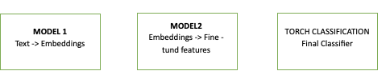
Model Architecture

Slide 12


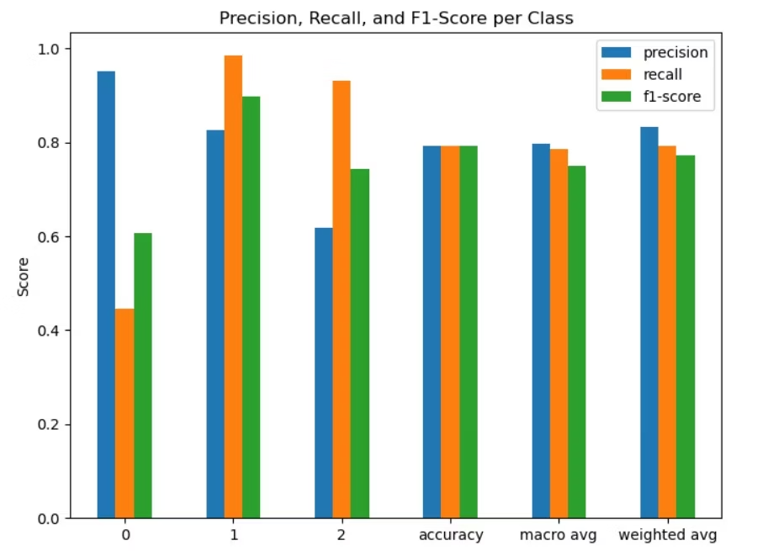



Multi-Stage Architecture Design
First Transformer: Embedding Generation
Trained using Masked Language Modeling to generate contextualized token-level embeddings from IELTS essay data, capturing essay structure and coherence.
Second Transformer: fine Tuned features
Consumes embeddings from the first transformer to find features for each sentence, fine-tuned on sentence-level rubric labels.
Simple Classifier: Classification
A lightweight classical classifier that ensures predictions with lower model confidence are double-checked, enhancing reliability.
Postprocessing: Reconstruction & Highlighting
Sentences are reordered to match original essay structure and color-coded based on rubric labels for visual feedback.

Slide 13
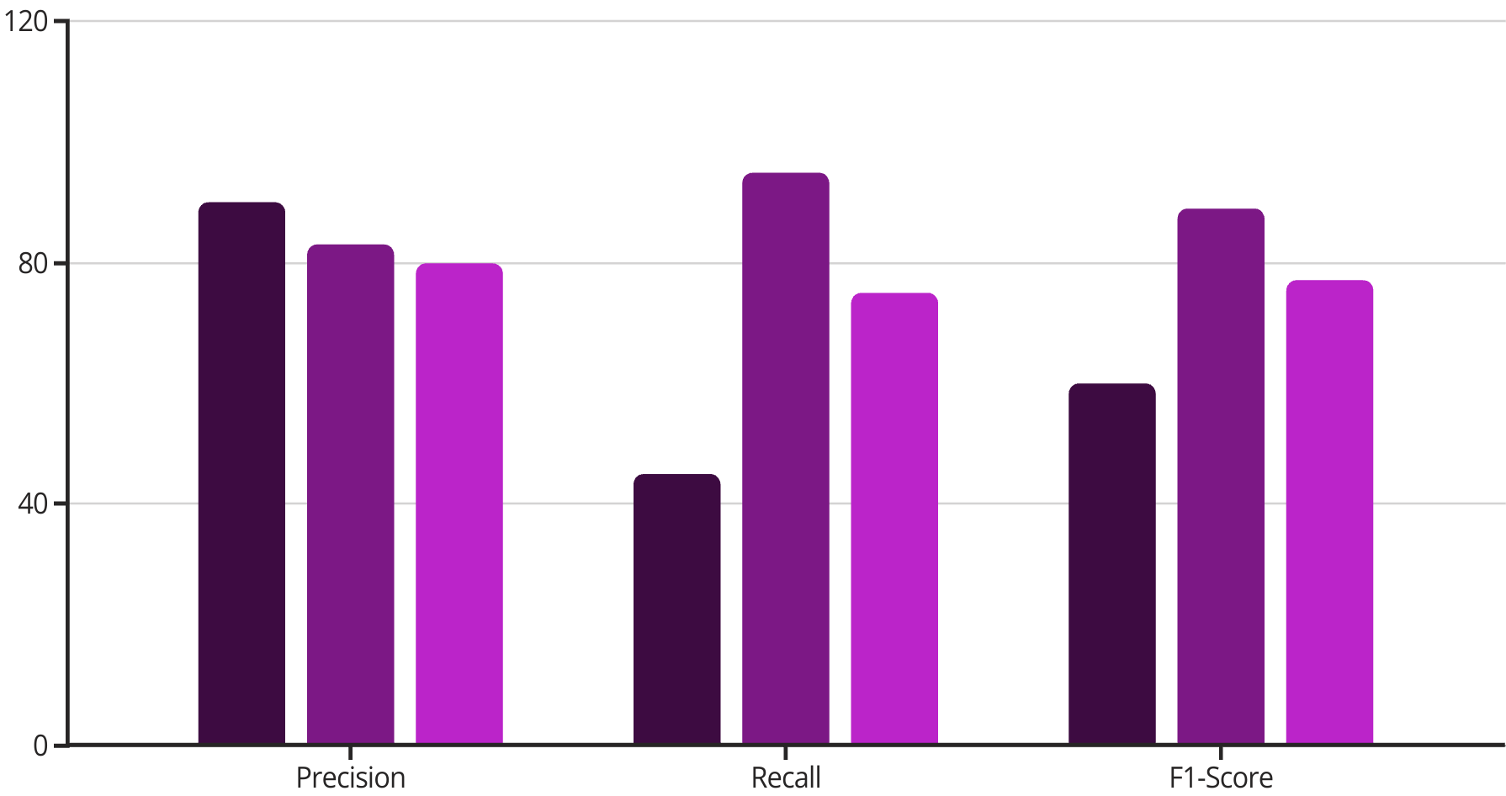
Model Performance Analysis
Task Response
Coherence & Cohesion
Lexical Resource
The model shows varying performance across different rubric categories. For Task Response, high precision (90%) but low recall (45%) indicates the model is very accurate when it predicts this category but misses many actual Task Response sentences.
Coherence and Cohesion classification performs exceptionally well with high recall (95%) and good precision (83%), suggesting reliable capture of sentences related to essay flow and structure. Lexical Resource shows balanced performance with good precision and recall.

Slide 14
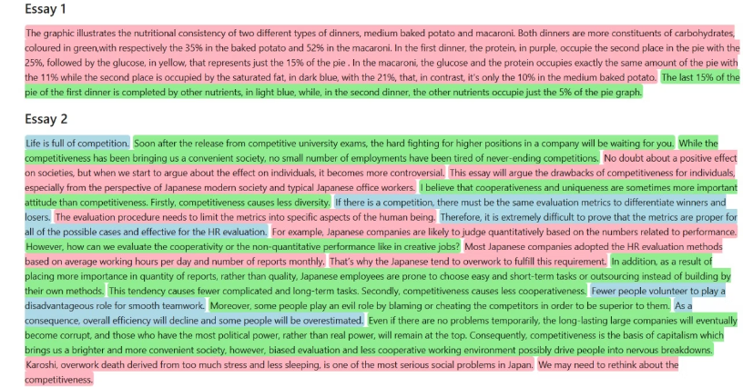
Final System Output Visualization
Task Response (Red)
Coherence and Cohesion (Green)
Lexical Resource (Blue)
Sentences that directly respond to the essay question, make arguments, or state key points are highlighted in red, showing how well the writer addresses the prompt.
Green highlights indicate sentences that ensure logical progression of ideas, using linking words and connecting paragraphs smoothly.
Blue highlights showcase sentences demonstrating rich and precise vocabulary usage, including topic-specific terms and collocations.

Slide 15
Conclusions and Future Directions
Key Achievements
Future Work
Successfully developed a transformer-based system for automated rubric-based evaluation of IELTS essays
Extend the model to classify Grammatical Range and Accuracy
Balanced strong performance with low computational cost using frozen transformer embeddings with lightweight classifiers
Hyper param tuning, dataset improvement
Improve GUI and deplyement
Created a visual feedback system that highlights sentences by rubric category

